Slide 1
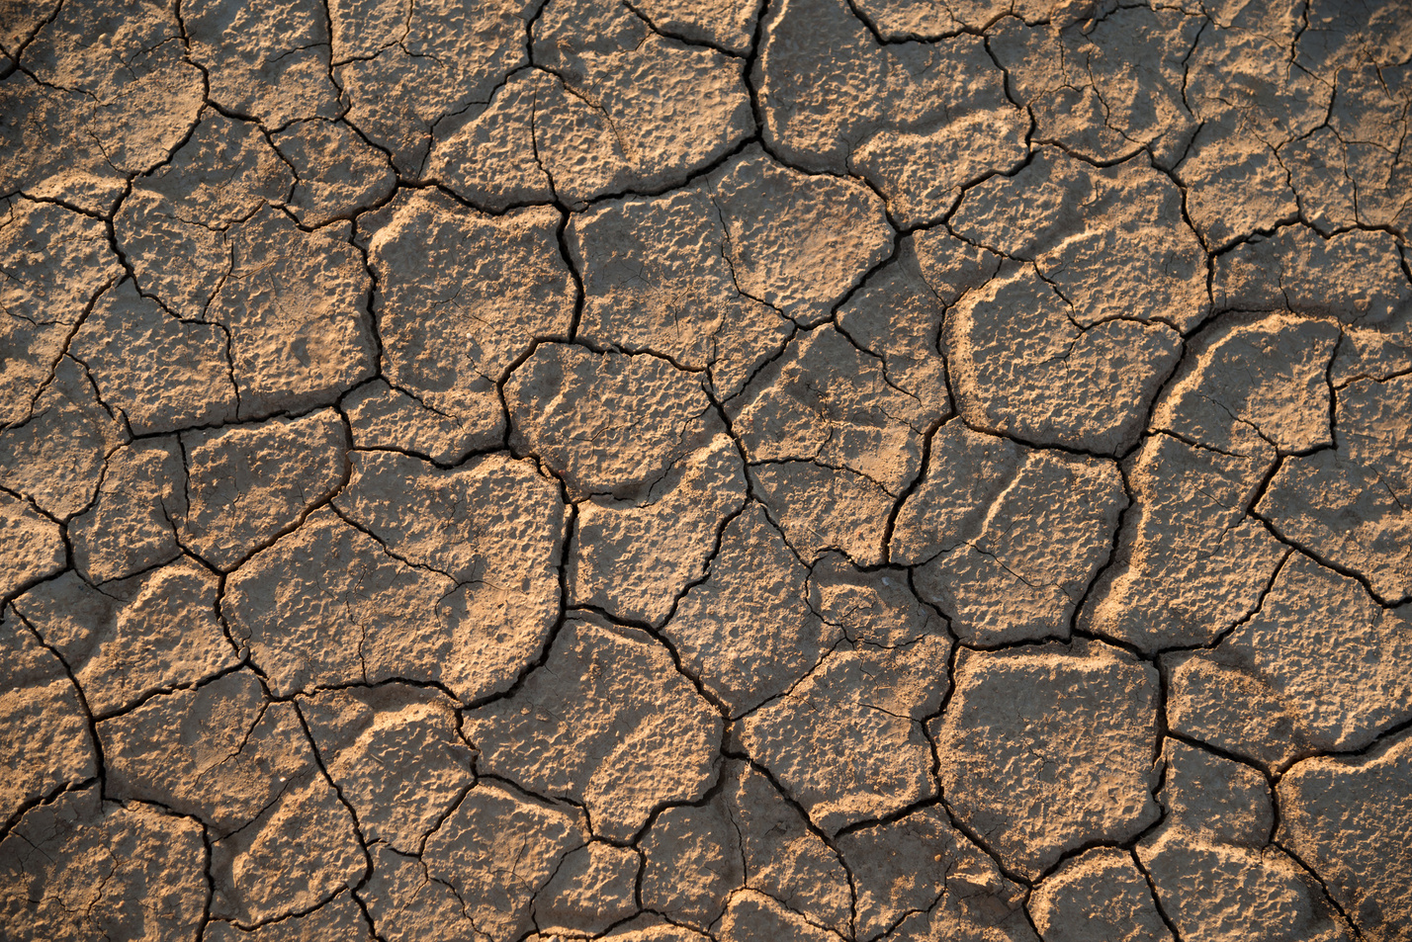
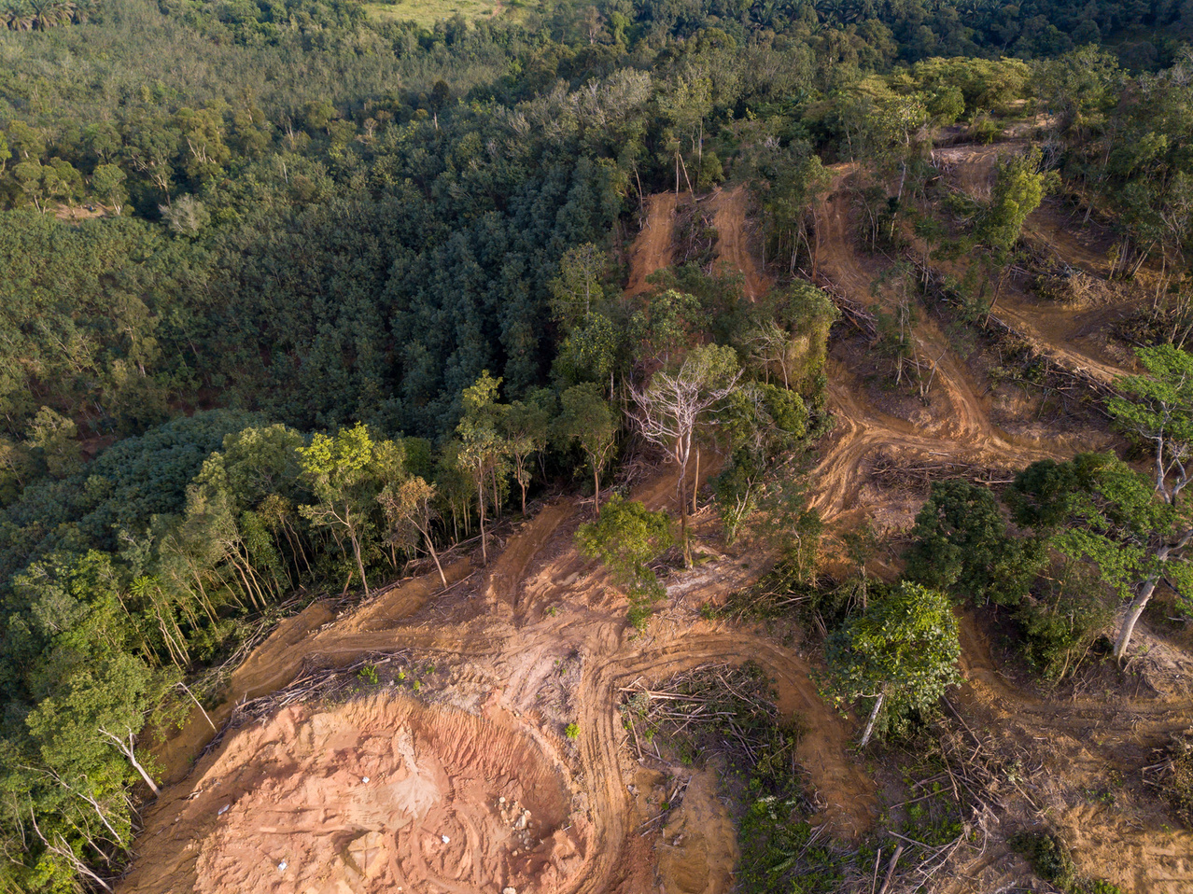

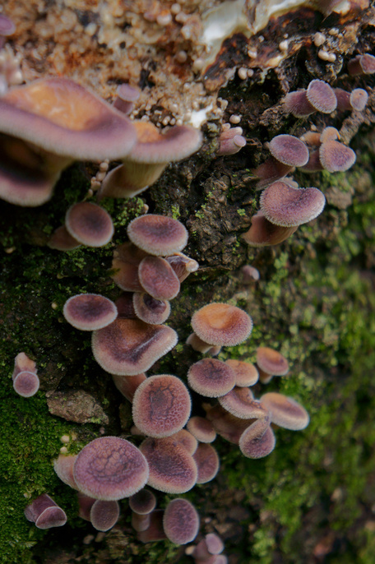

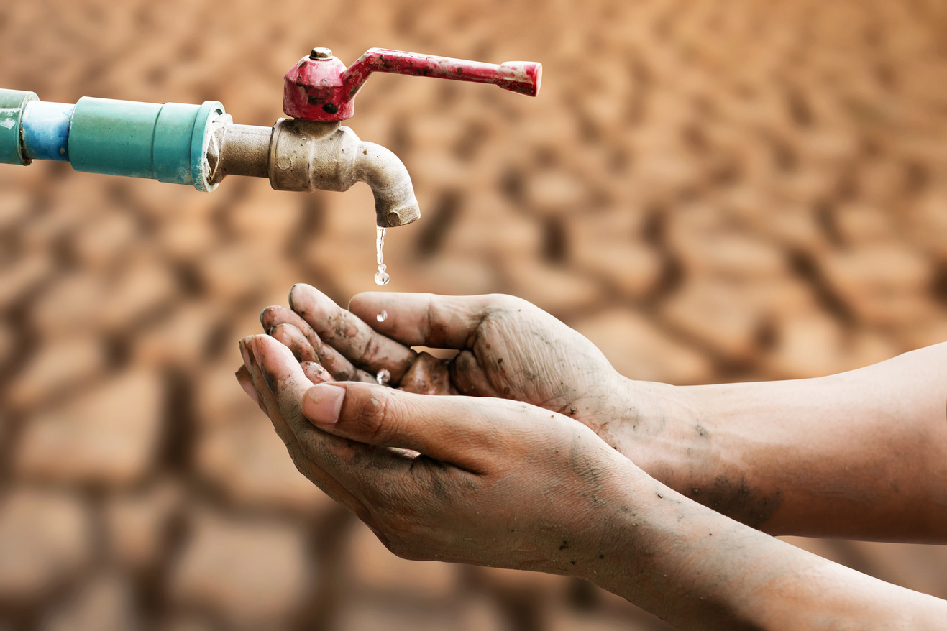
Environmental problem, it's CAUSES AND SUSTAINABILITY

Slide 2
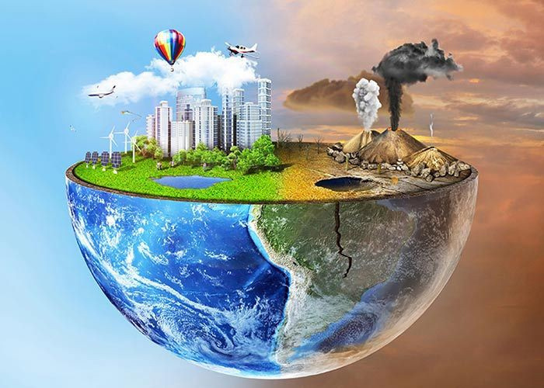
objectives
This presentation aims to define environmental problems, explore their causes, and discuss the concept of sustainability in relation to major environmental issues such as global warming, climate change, pollution, deforestation, biodiversity loss, and resource depletion.
Notes:
2

Slide 3
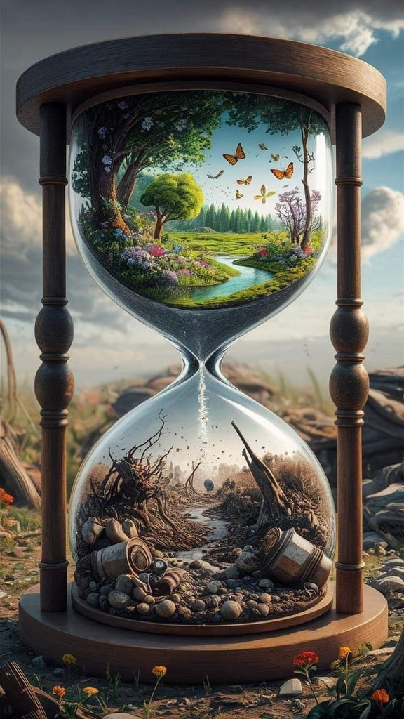


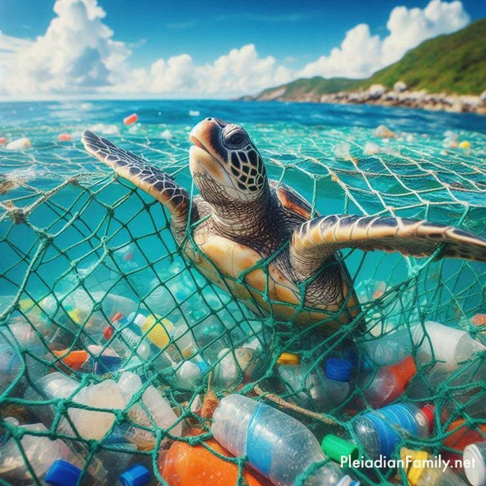
What is an environmental problem?
An environmental problem arises when human activities disrupt natural processes, leading to adverse effects on ecosystems and human well-being. These problems often stem from unsustainable practices that degrade the environment’s ability to provide essential resources and services.
This also means a harmful change or damage to the natural environment, including air, water, land, and living organisms, caused by human activities or natural resources.

Slide 4
What is an environmental problem?
An environmental problem arises when human activities disrupt natural processes, leading to adverse effects on ecosystems and human well-being. These problems often stem from unsustainable practices that degrade the environment’s ability to provide essential resources and services.

Slide 5
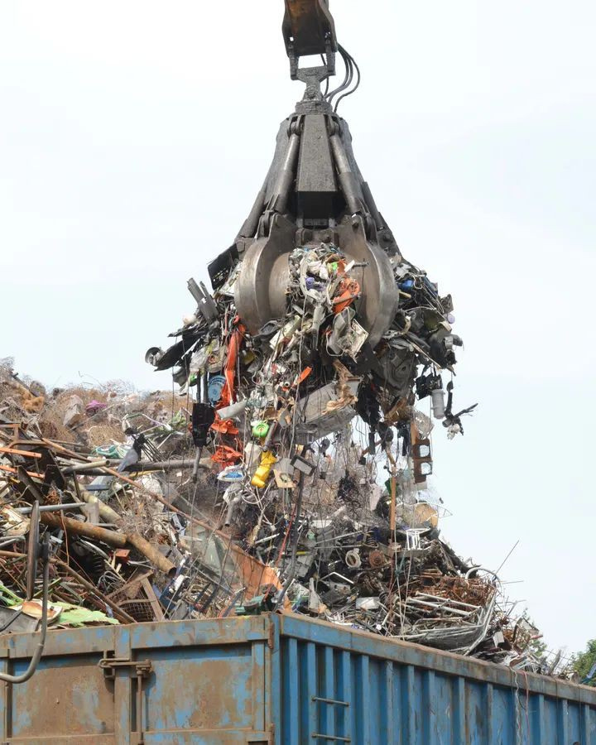
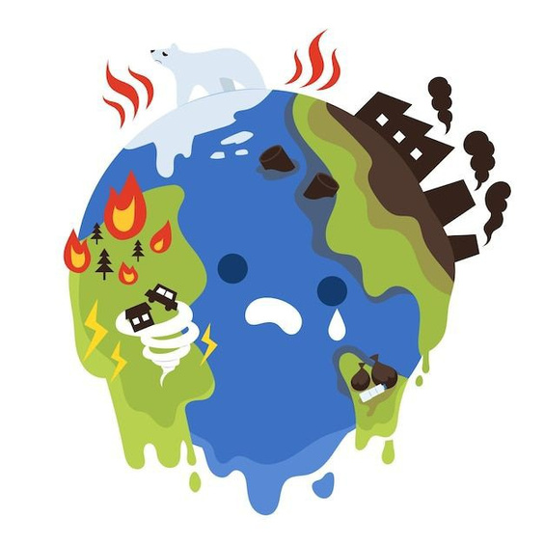
What causes environmental problem?
Human activities (pollution, deforestation, overconsumption) and natural factors (climate change, natural disasters) disrupt the balance of the environment, leading to harmful changes and damage to the air, water, land and living organisms.

Slide 6
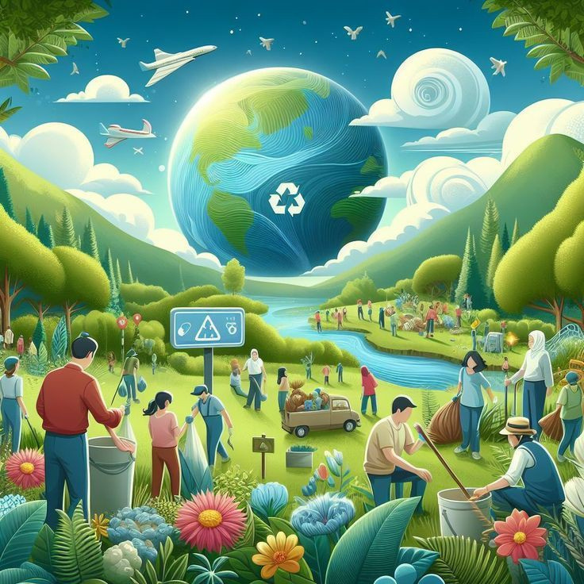

What is sustainability?
Sustainability refers to meeting the needs of the present generation without compromising the ability of future generations to meet their own needs. It involves balancing economic development, social equity. And environmental protection.

Slide 7
What is sustainability?
Furthermore, it is meeting the needs of the present without harming the ability of future generations to meet their own needs, by balancing economic, social, and environmental consideration.

Slide 8


ENVIRONMENTAL issues/problems: its causes and sustainability
Here are some issues/problems of the environment that we will discuss:
Global Warming
Climate Change
Pollution
Deforestation
Loss of Biodiversity
Resource Depletion

Slide 9
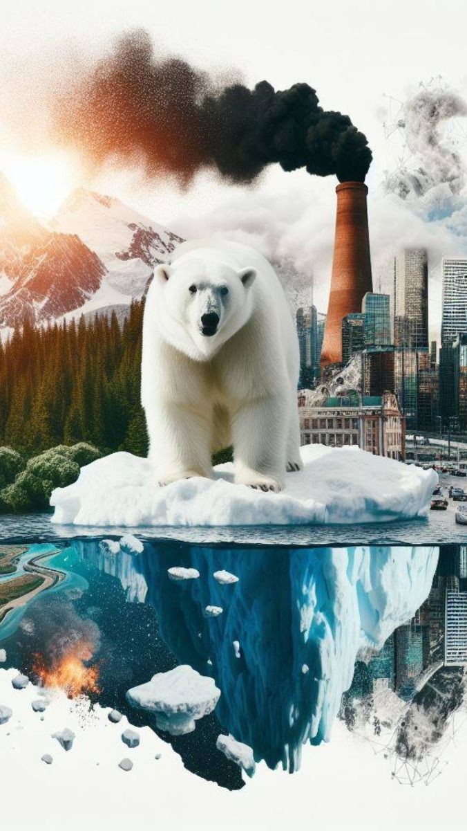
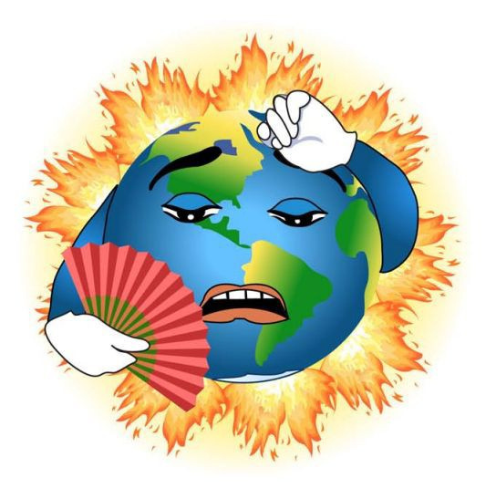

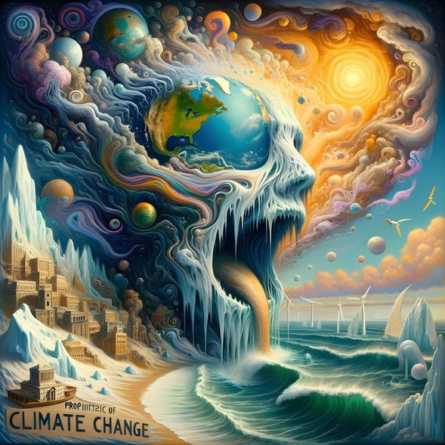
Environmental Problems, Its Causes and Sustainability
Global warming
Global warming is the long-term heating of Earth’s climate system observed since the pre-industrial period (between 1850 and 1900) due to human activities, primarily fossil fuel burning, which increases heat-trapping greenhouse gas levels on Earth’s atmosphere.
To put it simply global warming is the gradual increase in Earth’s temperature due to human activities releasing greenhouse gases.

Slide 10
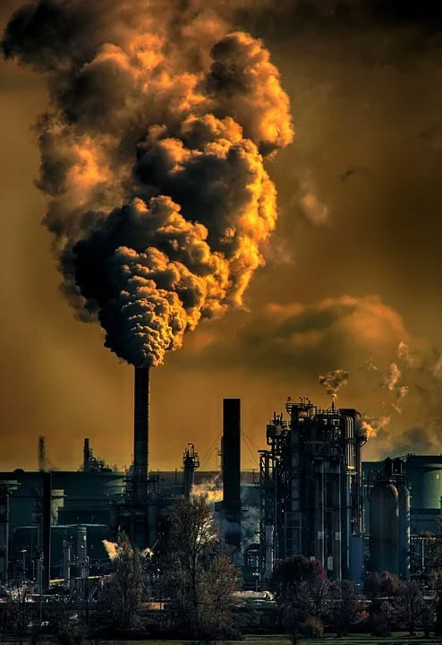
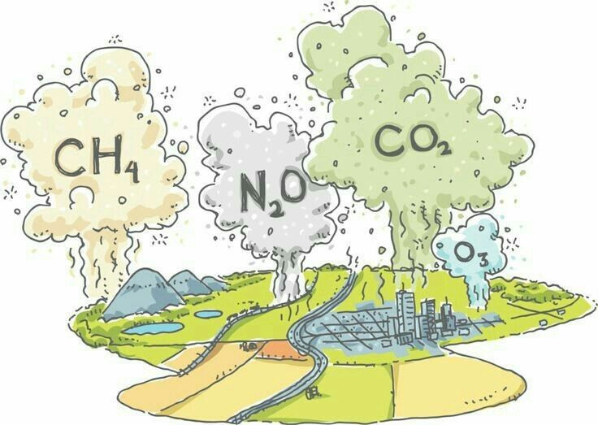

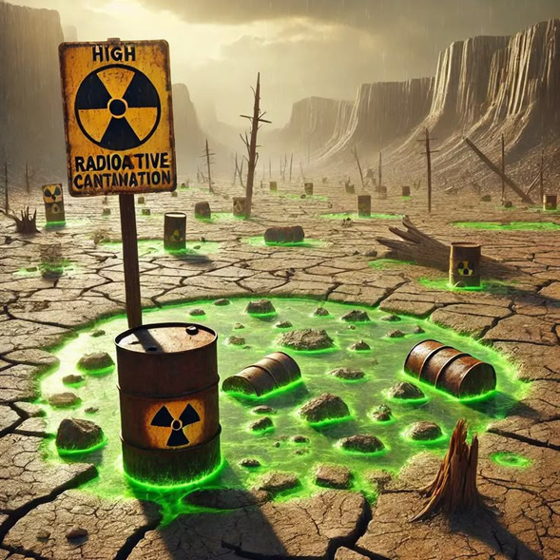
Environmental Problems, Its Causes and Sustainability
Causes of Global warming
The primary cause is the emissions of greenhouse gases are;
Burning of fossil fuels
Release of greenhouse gases into the atmosphere
Deforestation
Methane emissions
and industrial processes
Notes:
8

Slide 11
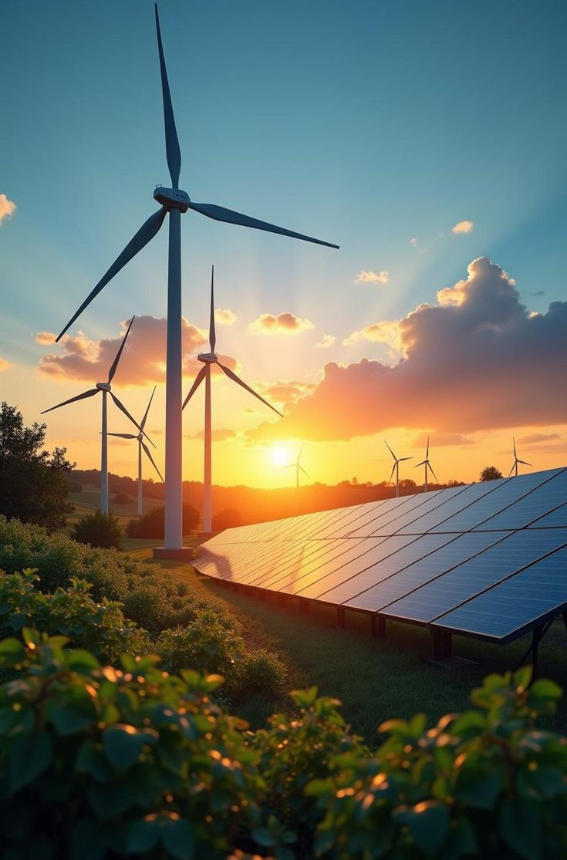
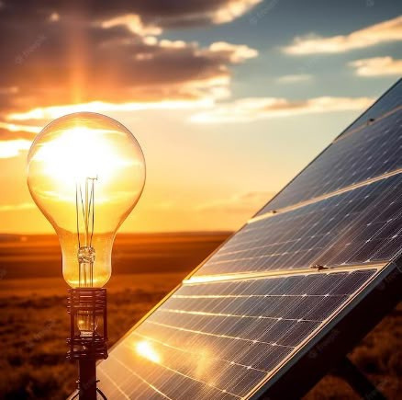
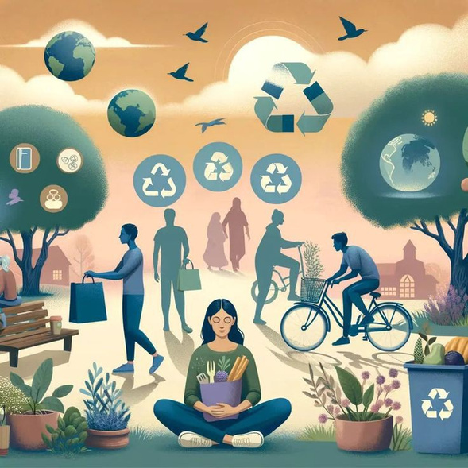
Environmental Problems, Its Causes and Sustainability
sustainability
Mitigation strategies includes;
Transitioning to renewable energy sources
Improving energy efficiency
and implementing carbon capture technologies.
Notes:
9

Slide 12
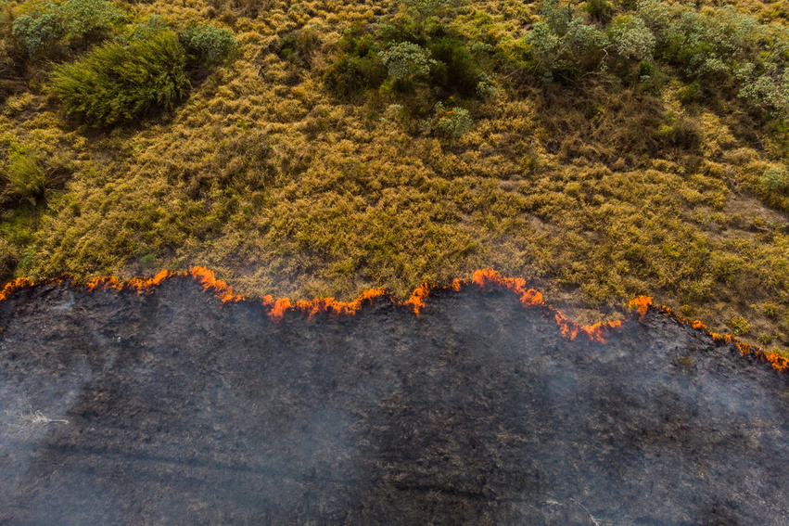
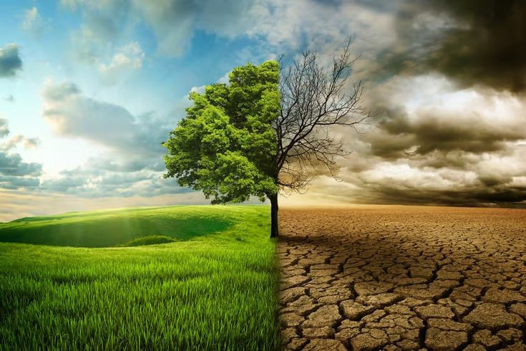
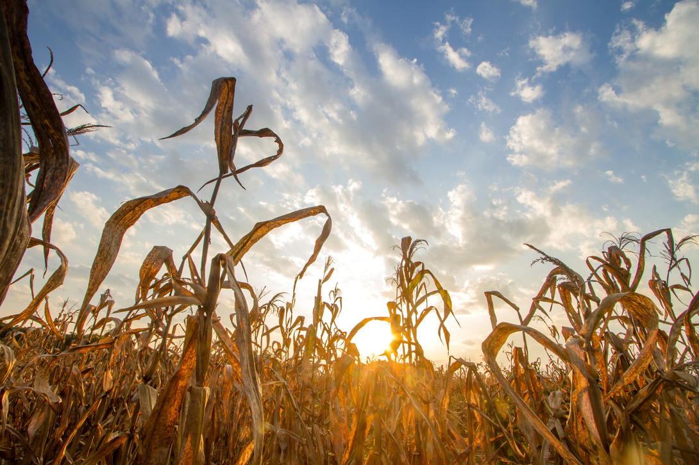
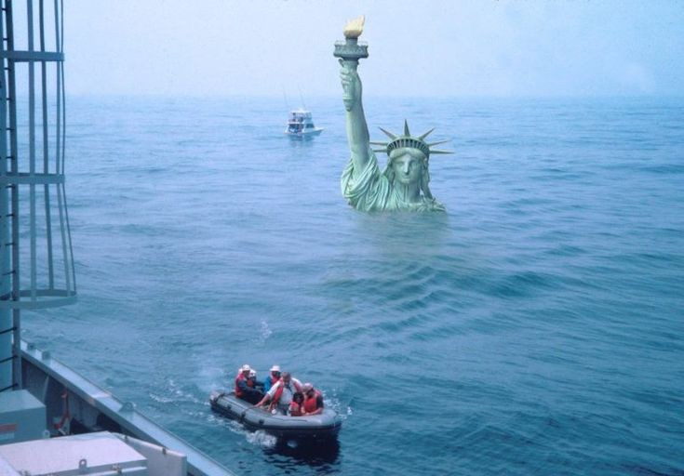
Environmental Problems, Its Causes and Sustainability
CLIMATE CHANGE
Climate change encompasses long-tern shifts in temperatures and weather patterns. These shifts may be natural, but since the 1800’s, human activities have been the main driver of climate change, primarily due to burning fossil fuels (like coal, oil and gas), which produces heat-trapping gases.
Climate change is the changes in the Earth’s weather and temperature due to human and natural factors. This contribute to global warming.

Slide 13
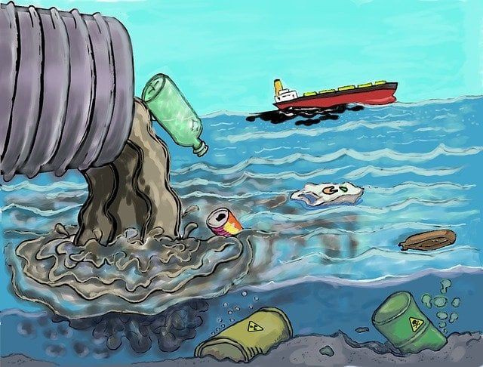
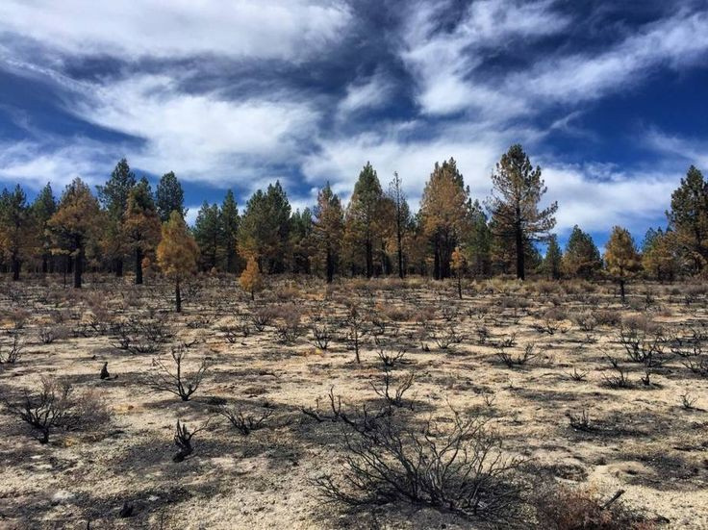
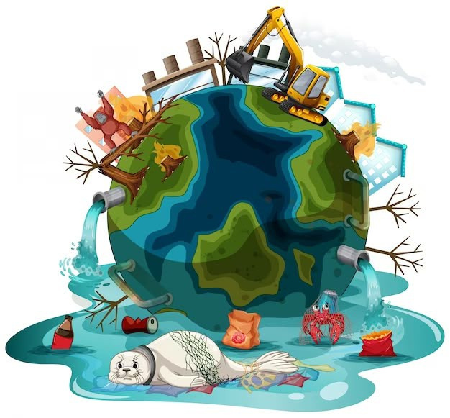
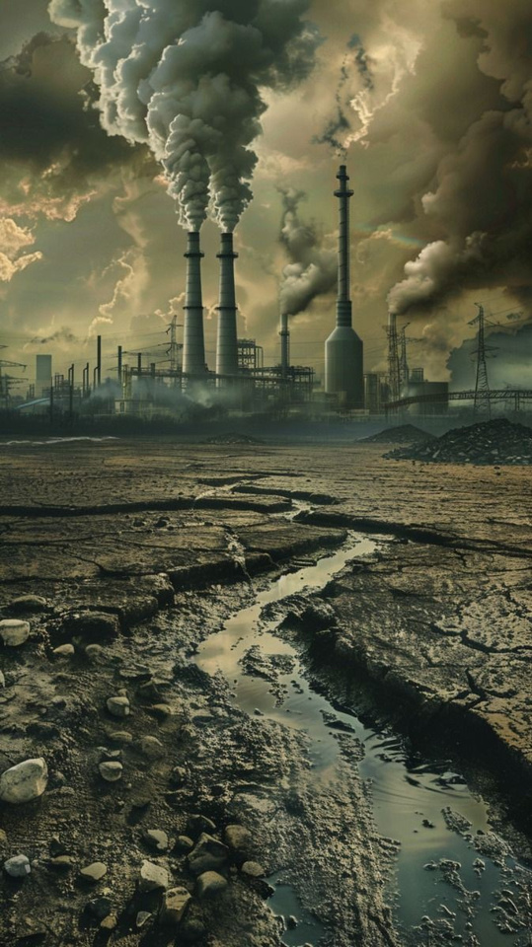
Environmental Problems, Its Causes and Sustainability
Causes of CLIMATE CHANGE
Cause by human activities, primarily;
Burning of fossil fuels
Release greenhouse gases into the atmosphere
Trapping heat
and altering global climate patterns
Notes:
11

Slide 14

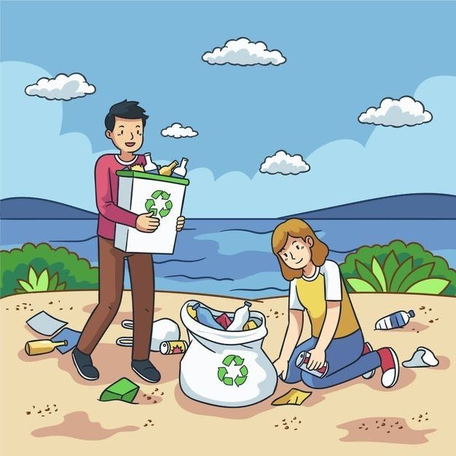
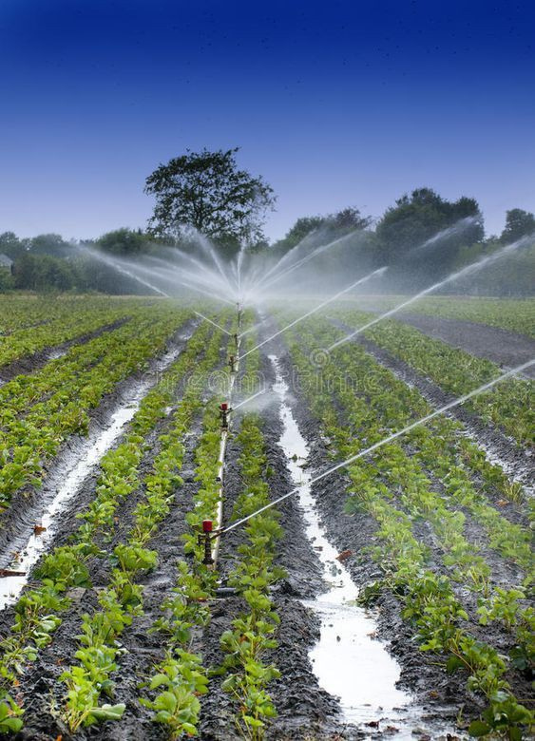
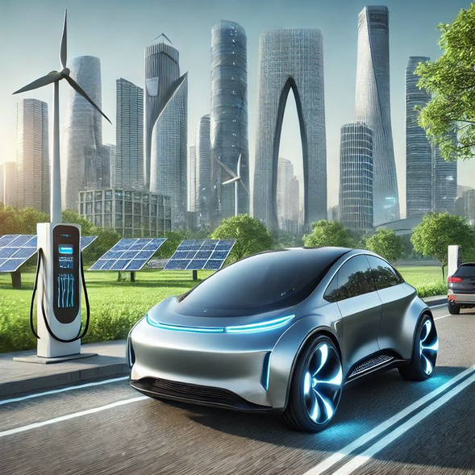
Environmental Problems, Its Causes and Sustainability
sustainability
Adaptation measures includes;
Developing climate-resilient infrastructure
Improving water management
and promoting sustainable agriculture.

Slide 15
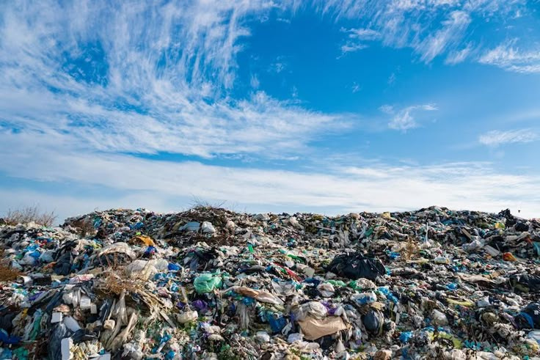
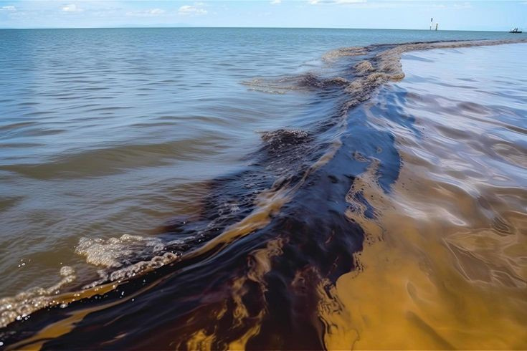
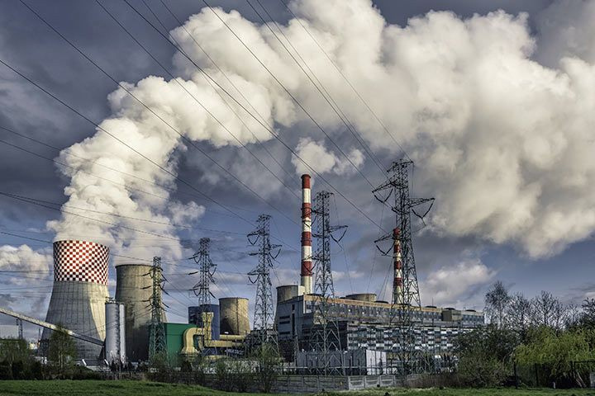
Environmental Problems, Its Causes and Sustainability
pollution
Pollution is the introduction of harmful contaminations into the environment, causing instability, disorder, harm or discomfort to the ecosystem i.e. physical systems or living organisms. Pollution can take form of chemical substance or energy, such as noise, water, air, and heat or light.
Pollution is the contamination of air, water, or land that harms the environment and living things.

Slide 16
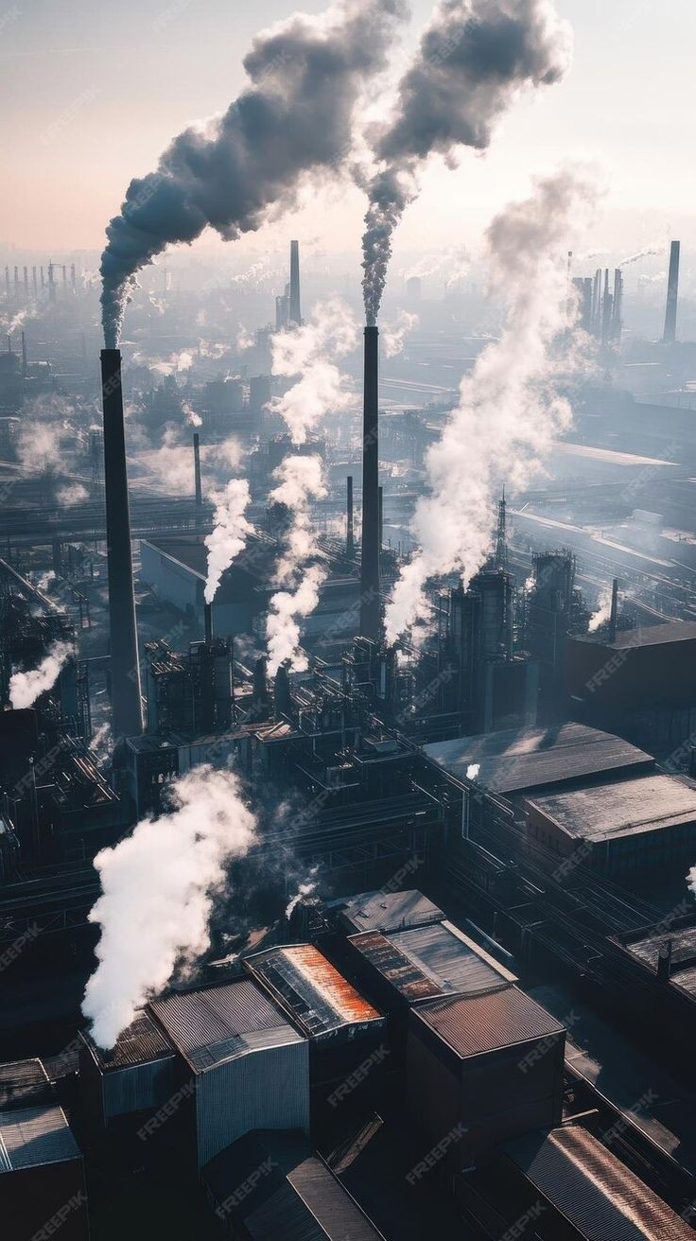
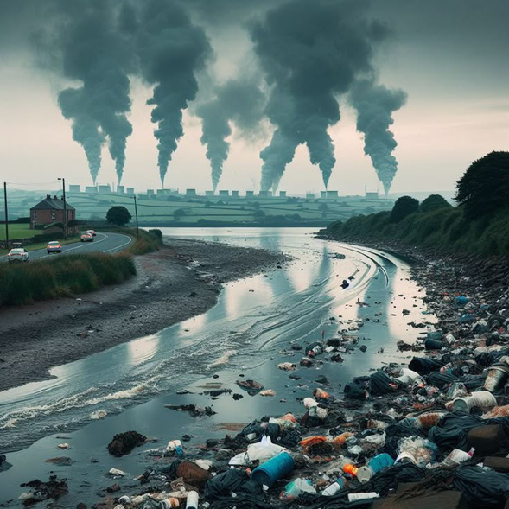
Environmental Problems, Its Causes and Sustainability
Air pollution
Air pollution refers to the contamination of the atmosphere by pollutants such as particular matter, ozone, nitrogen dioxide and sulfur dioxide.
Pollution is dirty air that harms people, animals and the environment. It’s caused by pollutants like smoke, dust and chemicals released into the air.

Slide 17
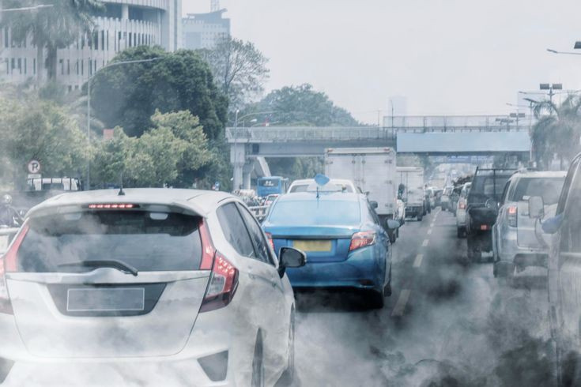
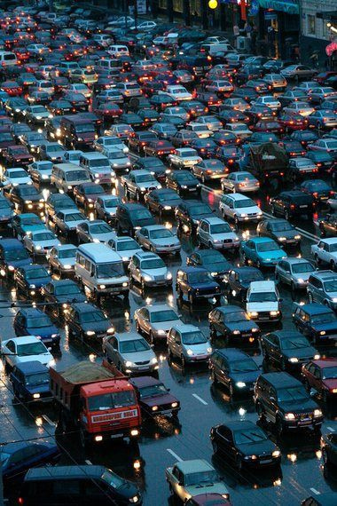
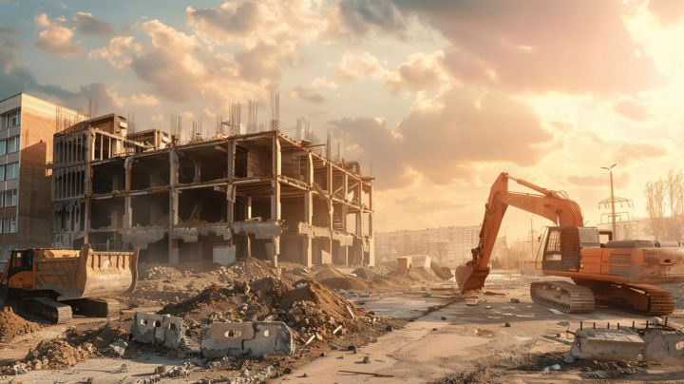
Environmental Problems, Its Causes and Sustainability
Causes of air Pollution
Industrial emissions
Vehicle exhaust
and burning of fossil fuels as major contributors to air pollution

Slide 18
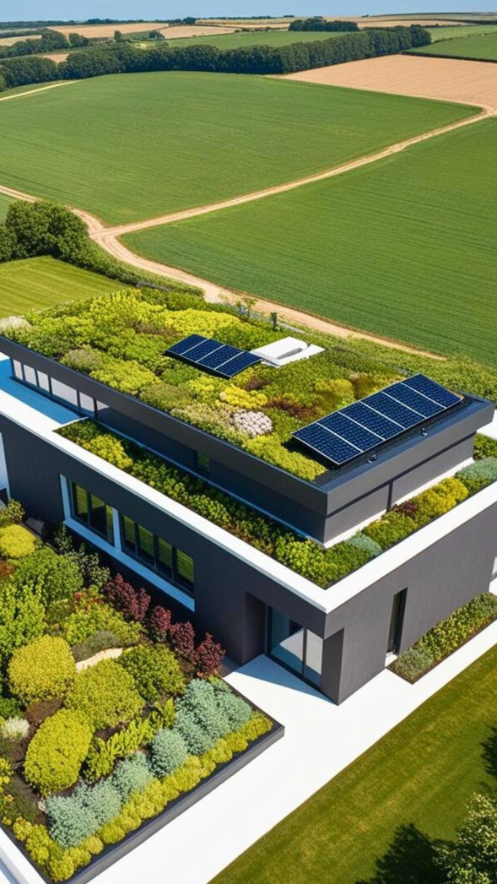
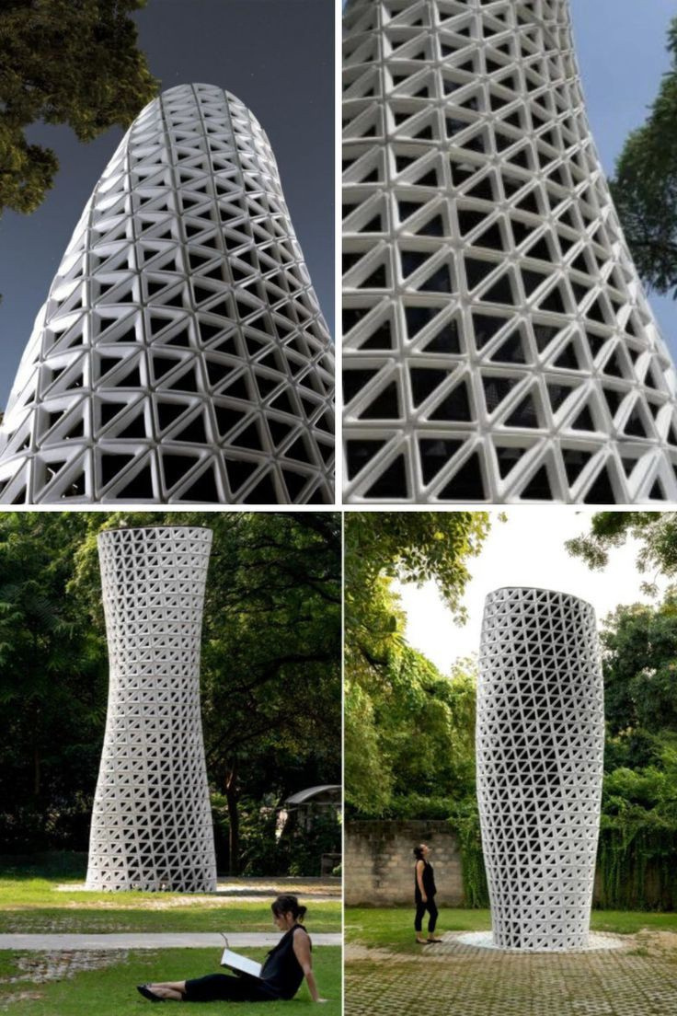
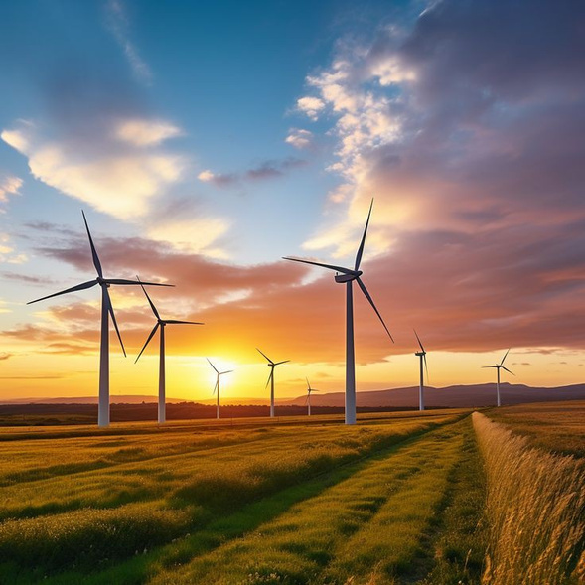
Environmental Problems, Its Causes and Sustainability
sustainability
Strategies include;
Transitioning to cleaner energy sources, increasing energy efficiency
Implementing stricter emission standards
and promoting sustainable transportation options can help reduce air pollution.

Slide 19
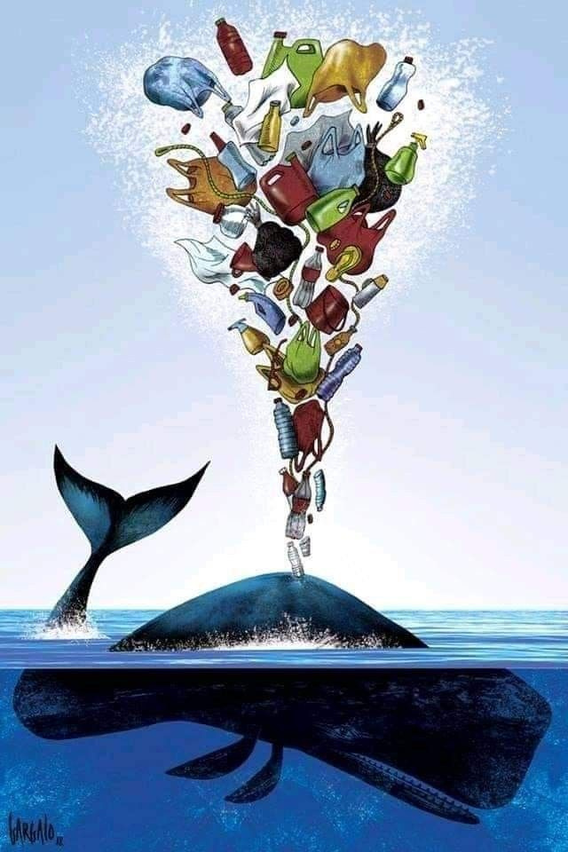
Environmental Problems, Its Causes and Sustainability
water pollution
Water pollution occurs when pollutants are discharged directly or indirectly into water bodies without adequate treatment to remove harmful compounds.
This is the contamination of water sources by harmful substances, such as chemicals, plastics, and waste, that can harm humans, animals, and the environment.

Slide 20
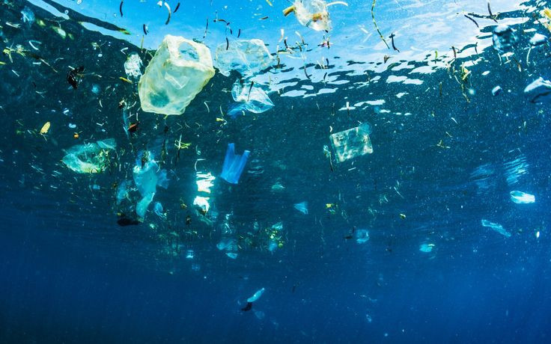
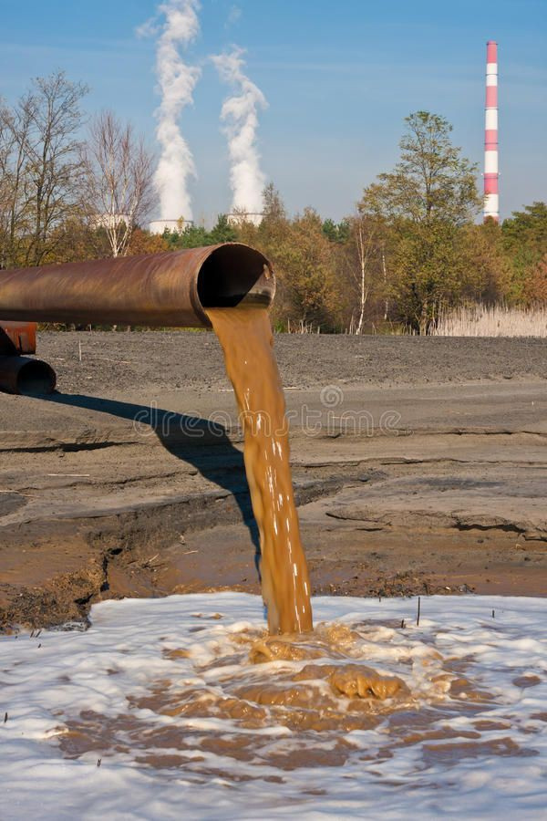
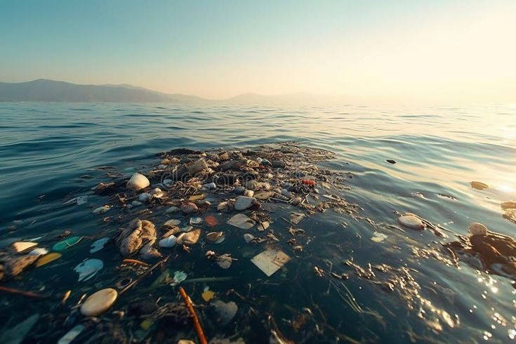
Environmental Problems, Its Causes and Sustainability
Causes of water Pollution
The causes of water pollution are;
Industrial discharge
Agricultural runoff
and sewage contamination are primary sources of water pollution

Slide 21
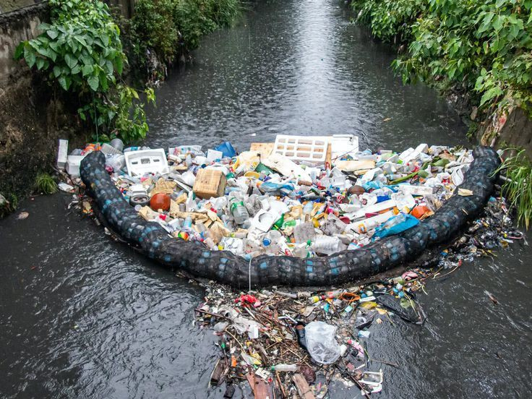
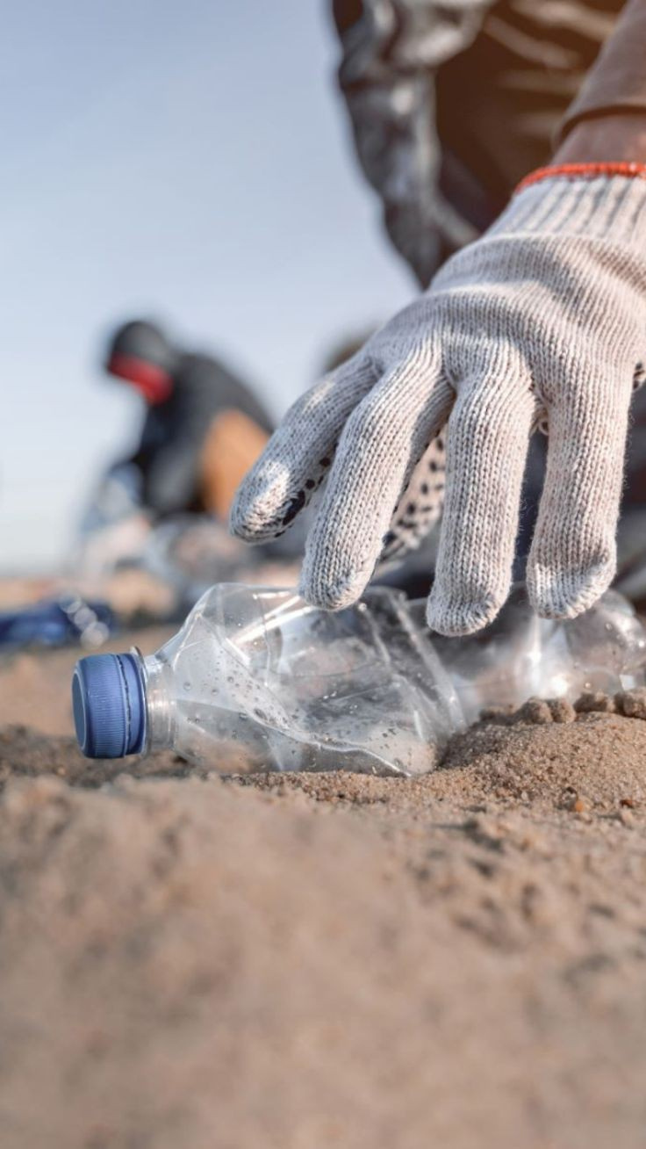
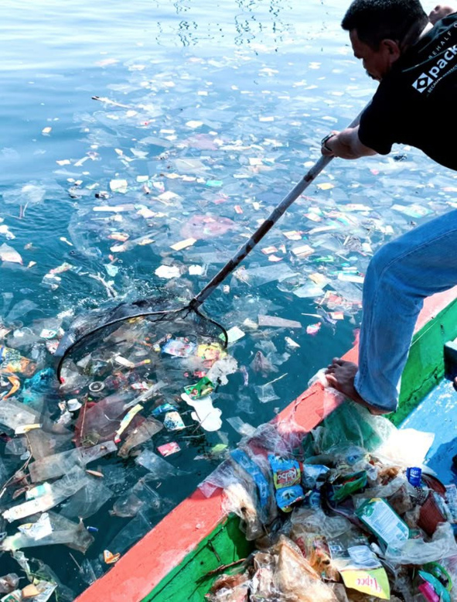
Environmental Problems, Its Causes and Sustainability
sustainability
Sustaining clean water requires a multi-faceted approach, including reducing industrial and agricultural waste, implementing effective wastewater treatment systems, and promoting responsible consumption practices. Protecting natural habitats, such as wetlands and forests, also help maintain water quality. Also, adopting sustainable agricultural practices, reducing plastic use, and supporting water conservation initiatives can collectively mitigate water pollution, ensuring a healthier environment and a secure water future.

Slide 22
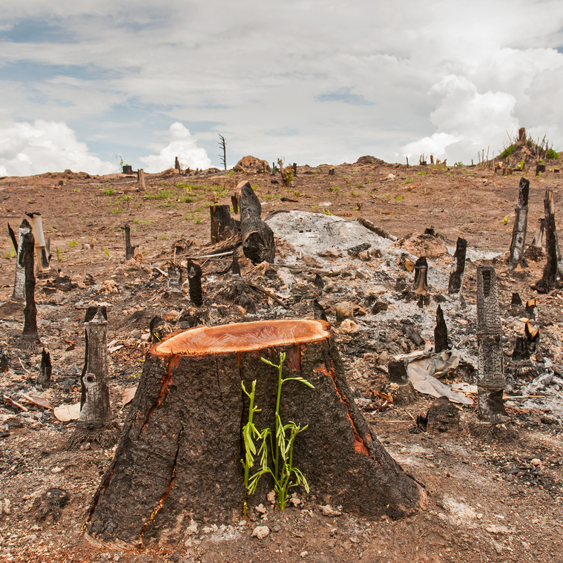
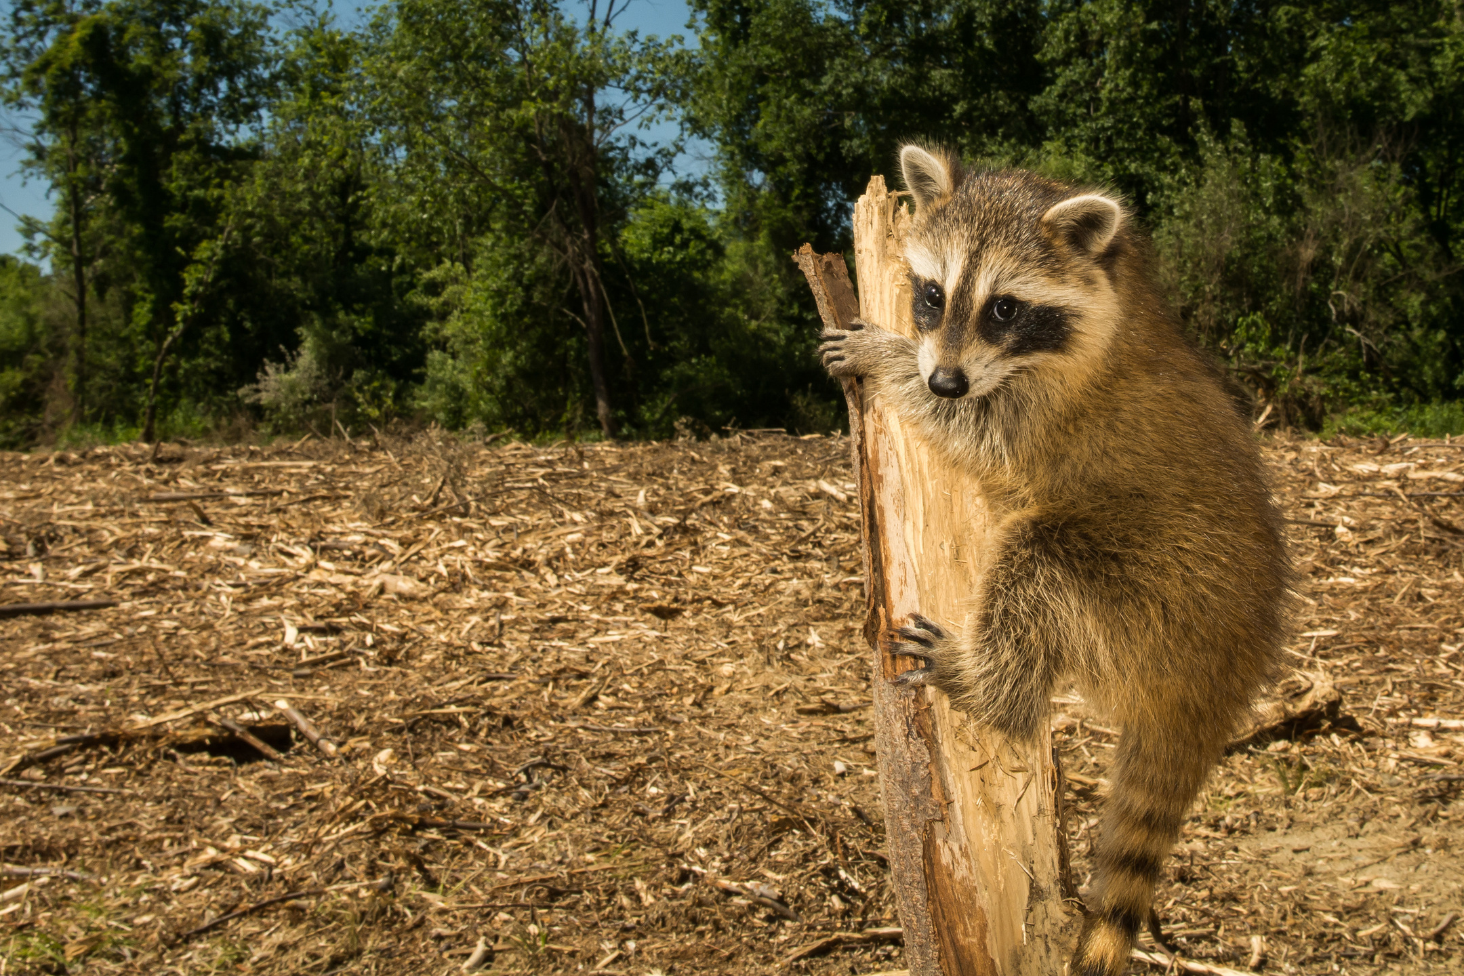


Environmental Problems, Its Causes and Sustainability
DEFORESTATION
Clearing forests for agricultural purposes, such as for crop cultivation or livestock grazing, can lead to habitat destruction, loss of biodiversity, and increased greenhouse gas emissions.
Simply deforestation is the clearing of forests for other land uses, such as agriculture, urbanization, or logging.

Slide 23



Environmental Problems, Its Causes and Sustainability
Causes of DEFORESTATION
Agricultural expansion
Logging
Human Population growth
Mining

Slide 24



Environmental Problems, Its Causes and Sustainability
Sustainability
Sustaining forests requires a concerted effort to adopt environmentally-friendly practices, such as;
Reforestation efforts
Sustainable forestry practices
Educating and Raising Awareness
Supporting Conservation Organizations

Slide 25

LOSS OF BIODIVERSITY
Loss of biodiversity refers to the decline in the variety or life on Earth, including the extinction of species and the degradation of ecosystems.

Slide 26



Environmental Problems, Its Causes and Sustainability
LOSS OF BIODIVERSITY
Conversion of natural habitats into agricultural land can result in the loss of biodiversity, as it disrupts the ecosystems that support various plant and animal species.
Loss of biodiversity is the decline or disappearance of plant or animal species.

Slide 27



Environmental Problems, Its Causes and Sustainability
Causes of LOSS OF BIODIVERSITY
The loss of biodiversity is primarily caused by human activities such as;
Habitat destruction and fragmentation
Pollution
Climate change
and overexploitation of resources

Slide 28



Environmental Problems, Its Causes and Sustainability
sustainability
Conservation efforts
Habitat restoration
and sustainable resource management

Slide 29





Environmental Problems, Its Causes and Sustainability
Resource depletion
Resource depletion refers to the consumption of finite resources at a rate faster than they can be replenished.
It is the exhaustion or reduction of natural resources, such as soil, water, minerals, and forests, due to over-consumption or unsustainable use.

Slide 30




Environmental Problems, Its Causes and Sustainability
Causes of Resource depletion
Overconsumption
Inefficient resource use
and population growth contribute to resource depletion or excessive extraction and exploitation of natural resources such as water, land, and minerals.

Slide 31




Environmental Problems, Its Causes and Sustainability
sustainability
Strategies include;
Promoting resource efficiency
Reducing consumption
and developing renewable alternatives.

Slide 32
Human Impacts on Earth Systems
THANK YOU FOR LISTENING.

